Slide 1
HOOVER THE ROBOT VACUUM CLEANER
GROUP-22

Slide 2

PROBLEM STATEMENT
Cleaning floors can be a tedious and time-consuming task, especially in larger homes or office spaces.
Traditional vacuum cleaners/brooms require manual operation, which can be physically demanding and time-consuming.
Many people face serious back pain due to cleaning with a broomstick or vacuum cleaner.
A more convenient and efficient cleaning solution that saves time and effort for users, while also improving the hygiene and air quality of the space is required.

Slide 3

OUR SOLUTION

Slide 4
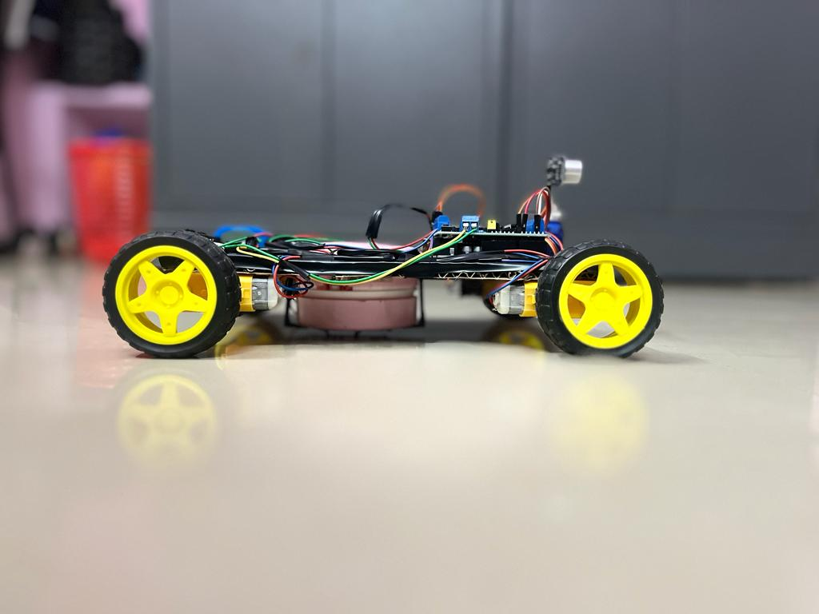
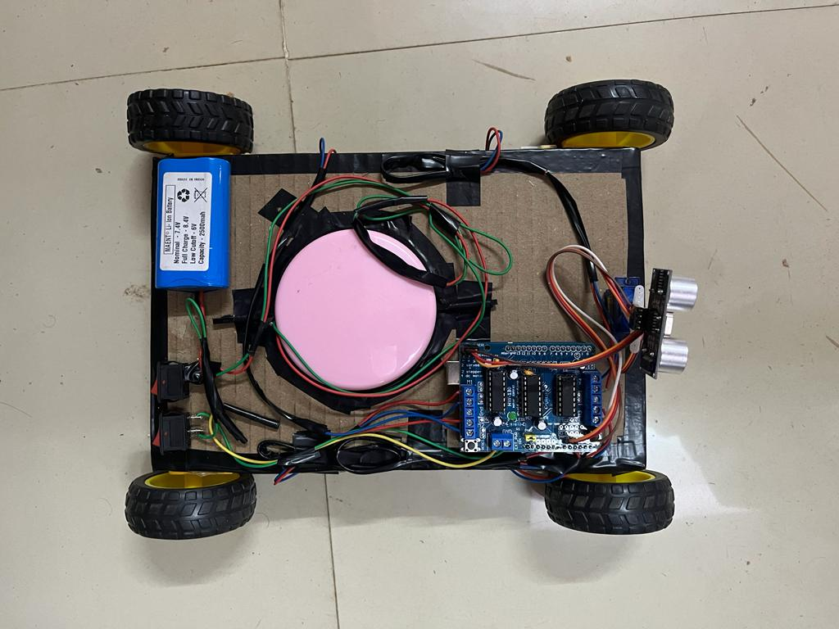
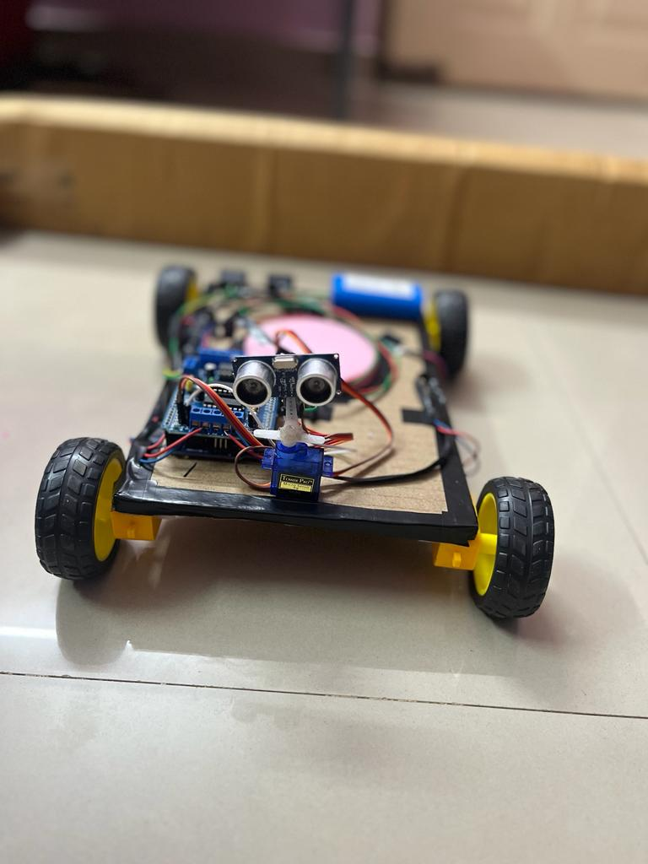
A ROBOT VACUUM CLEANER!

Slide 5
HOW DOES OUR SOLUTION SOLVE THE PROBLEM?
It automates the process of cleaning thus decreasing manual effort.
WORKING:-
It uses the following concepts to achieve this:
Navigation: The robot vacuum cleaner uses sensors, such as ultrasonic or infrared to avoid obstacles and navigates around the room.
Suction: The robot vacuum cleaner has a motor that creates suction to pick up dirt and debris from the floor.
Microcontroller: The robot vacuum cleaner takes instructions(which are written via code) from a microcontroller like Arduino Uno.
Power: The robot vacuum cleaner has a rechargeable battery, which provides power for cleaning.

Slide 6
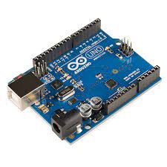
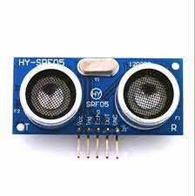
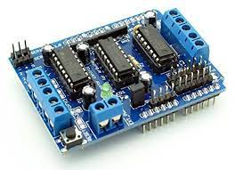
COMPONENT AND FABRICATION DETAILS:
Microcontroller: Arduino Uno and Arduino Motor Shield
Sensor: Ultrasonic Sensor
Power: Rechargeable Li-ion battery(7.4v), Switch
Servo Motor
Portable Vacuum Cleaner
Gear Motor with Wheels
Wires and Jumper Wires
Cardboard was used to make the base.
Support hooks were 3-D printed to hold the vacuum cleaner.
All the other components were attached with either wires or glue.
Arduino Uno
Ultrasonic sensor
Motor Shield

Slide 7
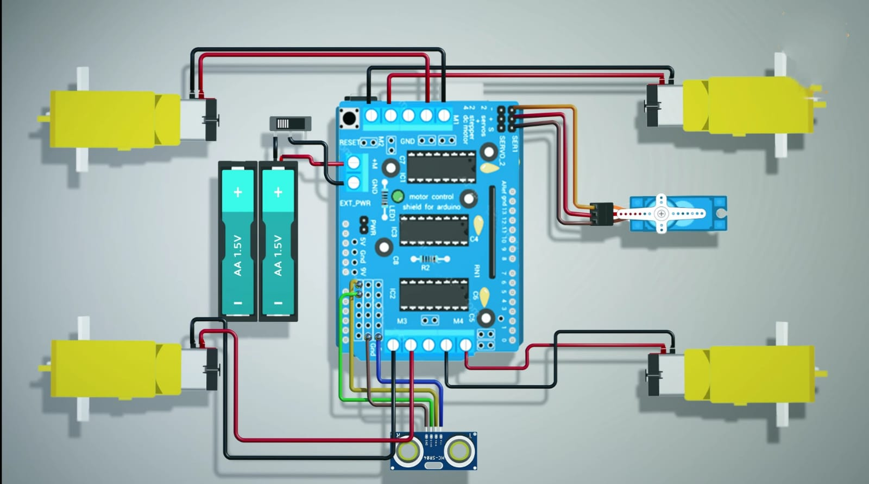
SCHEMATICS

Slide 8
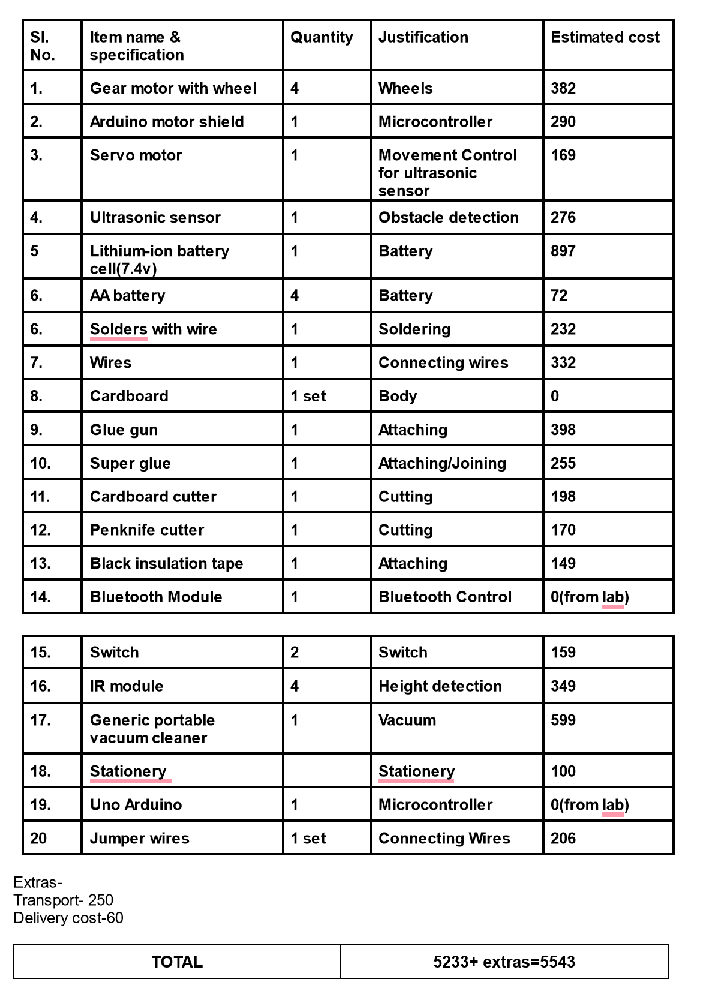
BUDGET

Slide 9
THANK YOU
-Team-22
MALAKA KISHORE (TL) (112201035)
SAI TEJESWAR(132201031)
GUNADEEP(102201027)
TANISHK (122201030)
RAM CHARAN (122201039)
GANESH (112201031)
AKHILESH (132201028)
CHANDU (112201025)
Notes:
With this, I conclude my presentation. Thank you.

